Slide 1
Find My subway
202235134 최민석

Slide 2
Contents (index)
Motive
App’s feature
Project files
Used library
Function explain
Demo

Slide 3
motive
Low visibility.
Too complex.

Slide 4
App’s feature.
Find subway stations by GPS and search.
Check real time location.
Supports dark-mode.

Slide 5
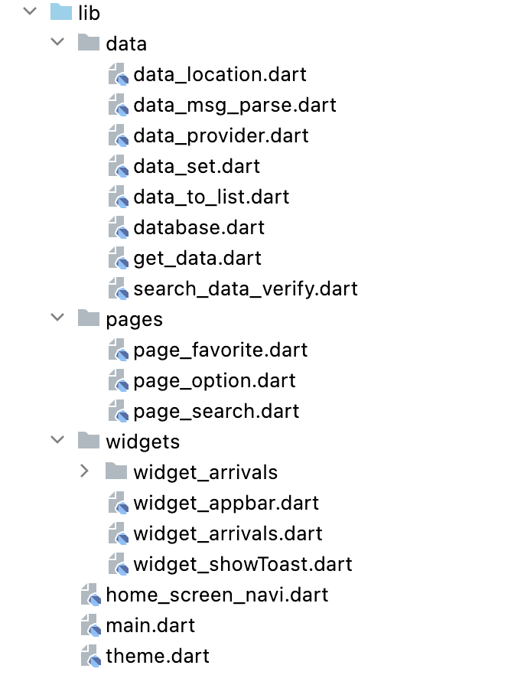
project files
I divided files by roles.

Slide 6
used library
http: ^0.13.5 // to access api search_page: ^2.3.0 // to make search page fluttertoast: ^8.1.2 // shows toast message sqflite: ^2.2.4+1 // to save user’s list shared_preferences: ^2.0.17 // to save theme data path: ^1.8.3 // to load db file provider: ^6.0.5 // to change theme geolocator: ^9.0.2 // to locate by gps

Slide 7
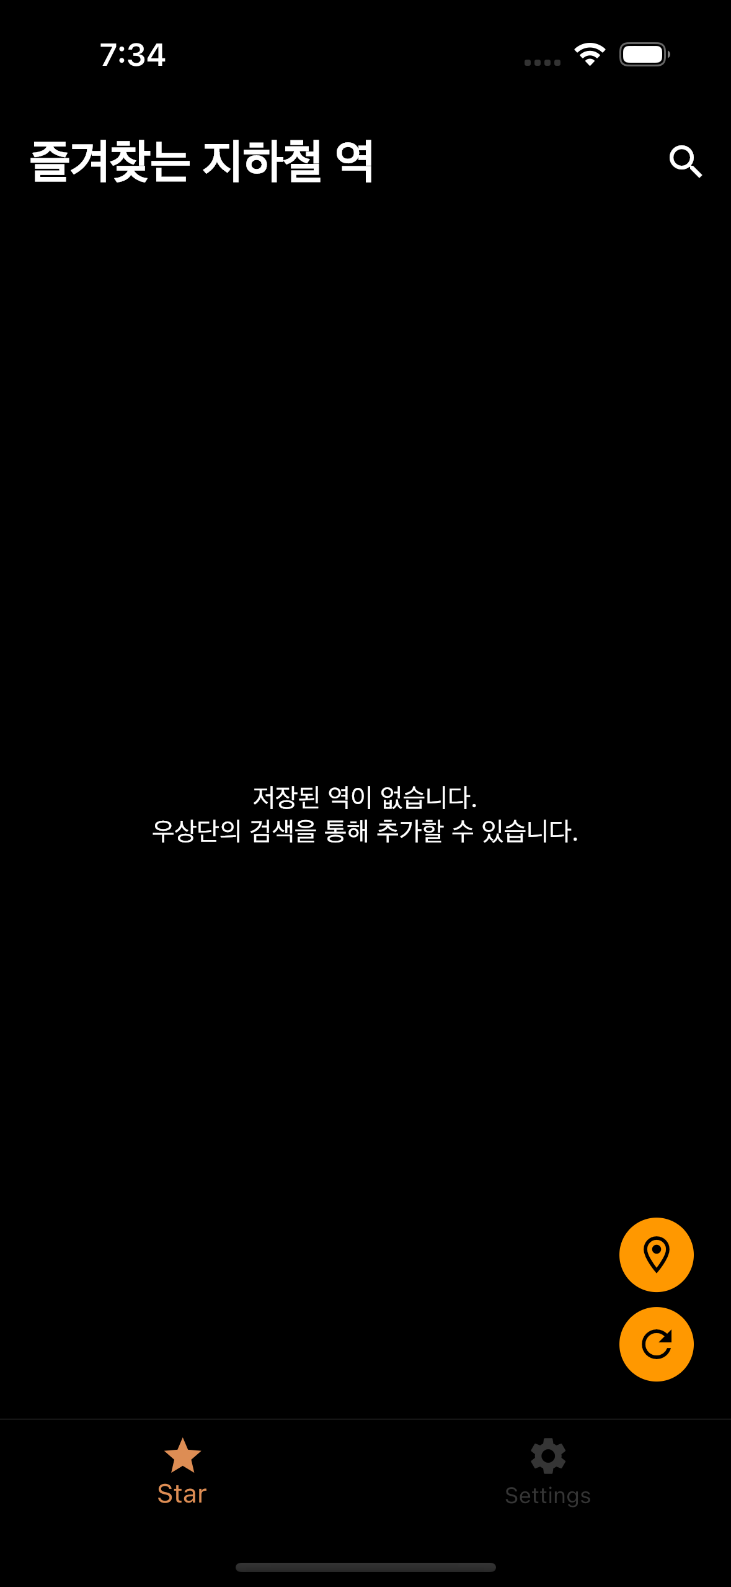
main screen
1
Search
Add location by GPS
Refresh
Settings
2
3
4

Slide 8
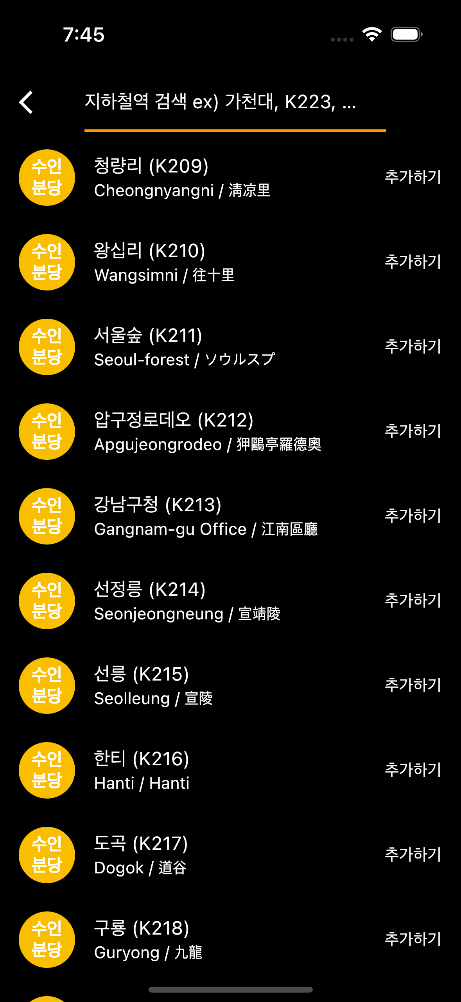
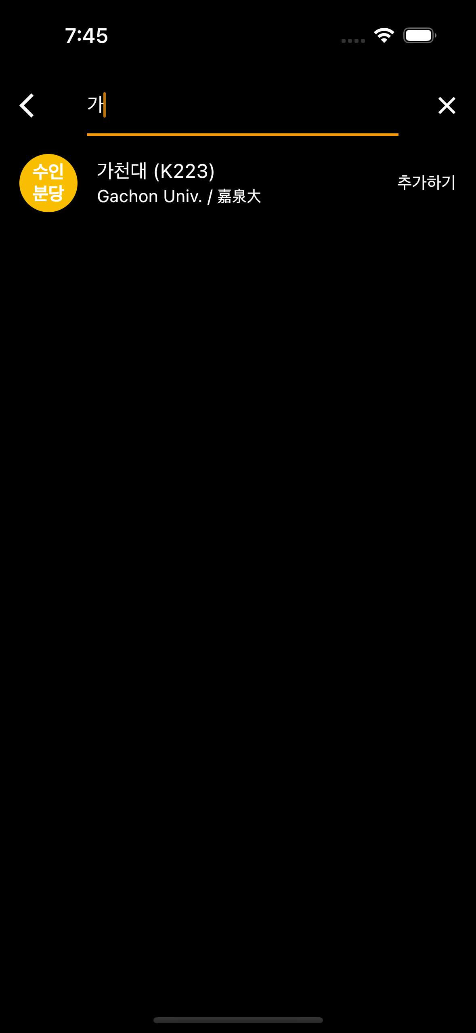
1. search
You can add stations by search.
I can get stations information by api.
And I used search_page api to make search list.

Slide 9
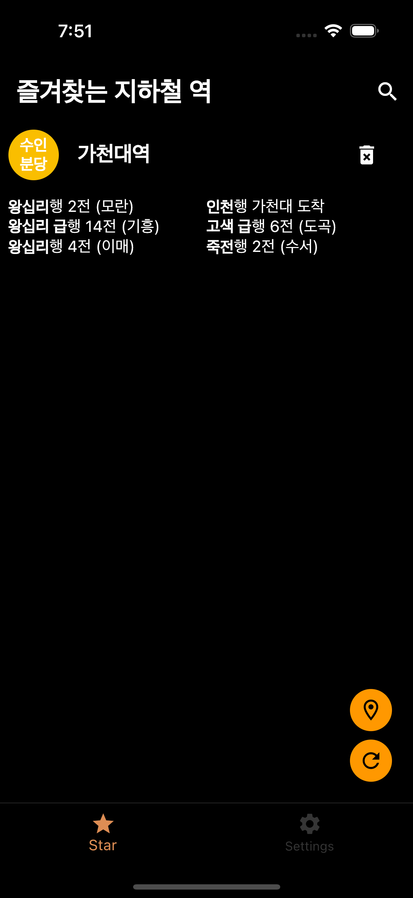
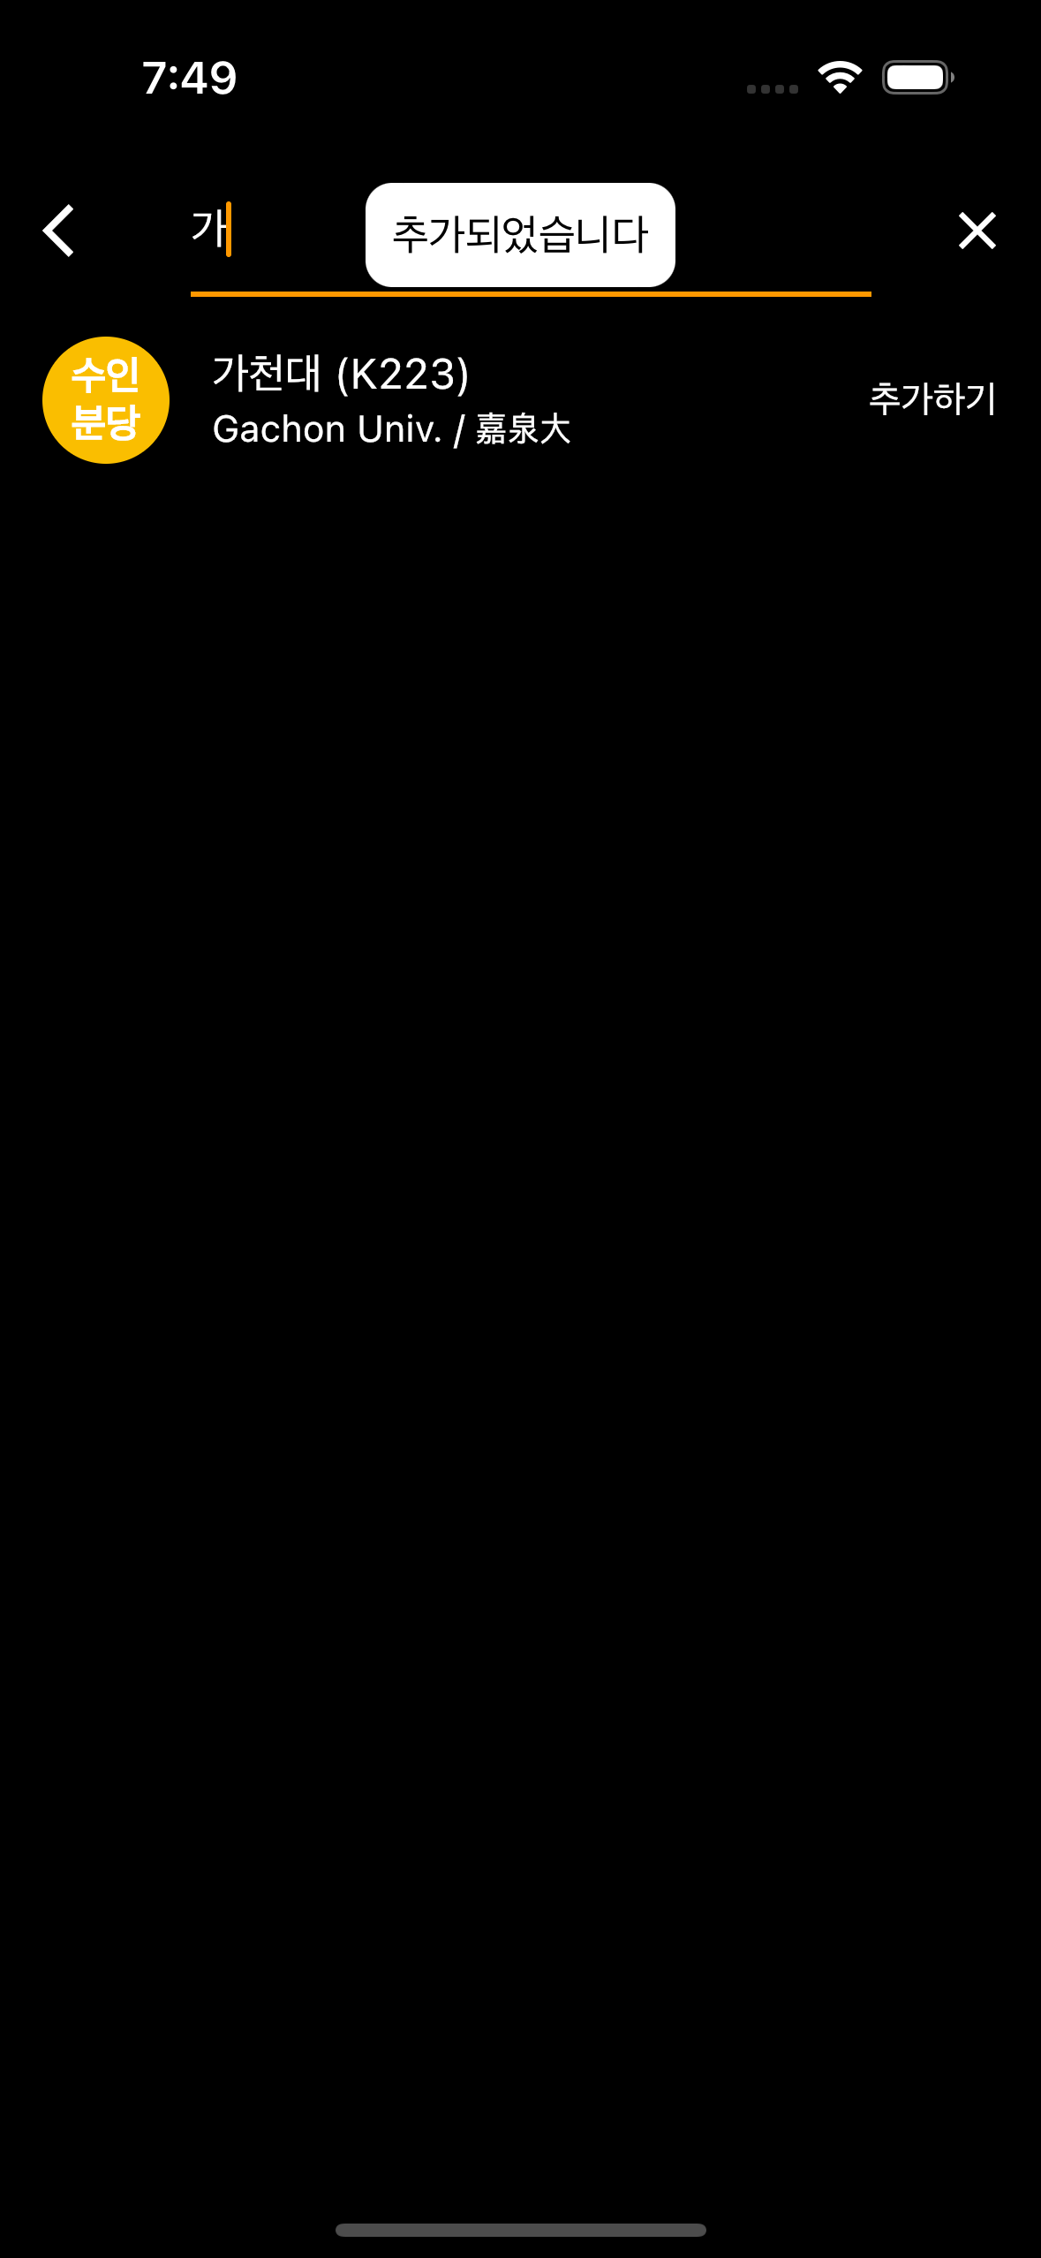
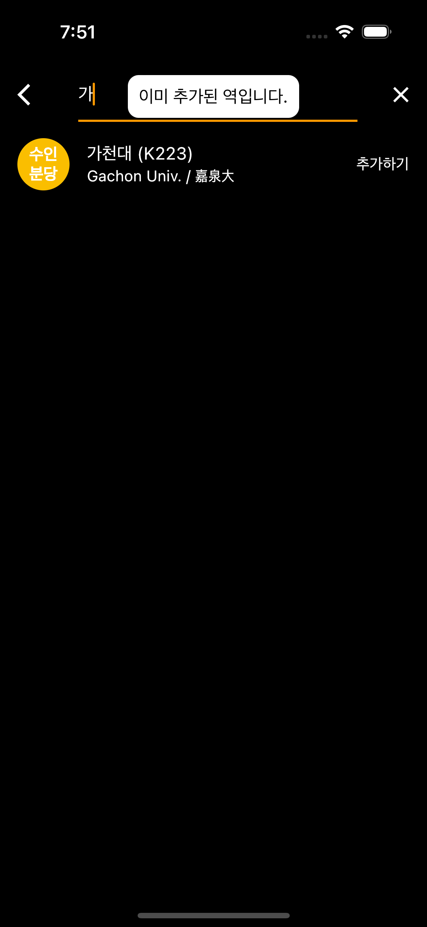
1. search
Touch tile, add to list.
When touch, It shows by toast.
Already added, It shows

Slide 10
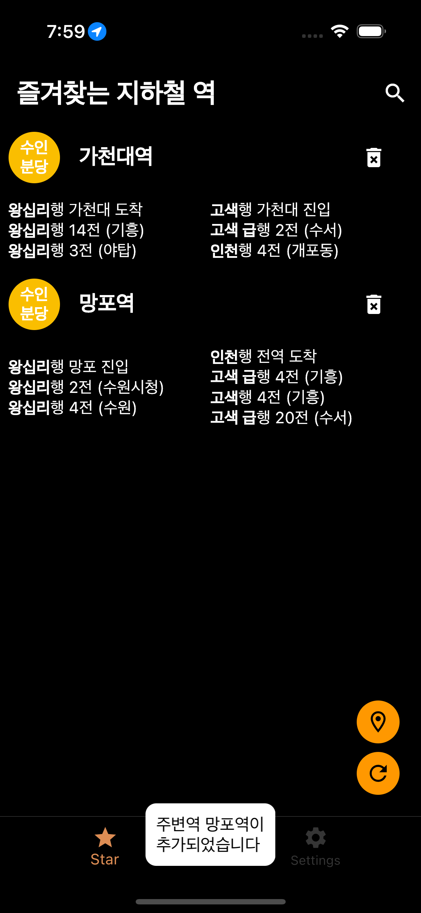
2. add location by gps
Press gps button to add your station.
geolocator can get my location.

Slide 11
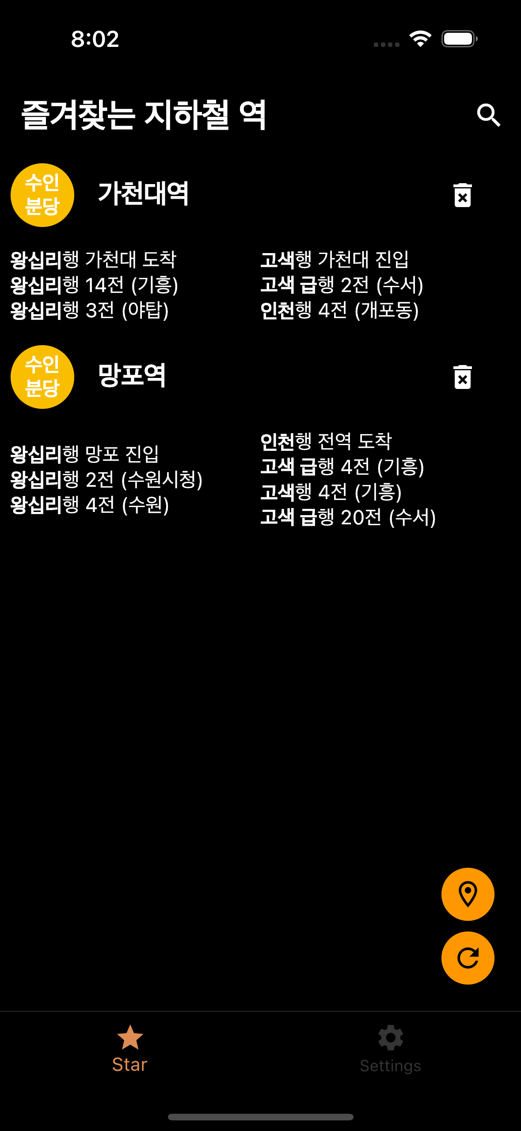
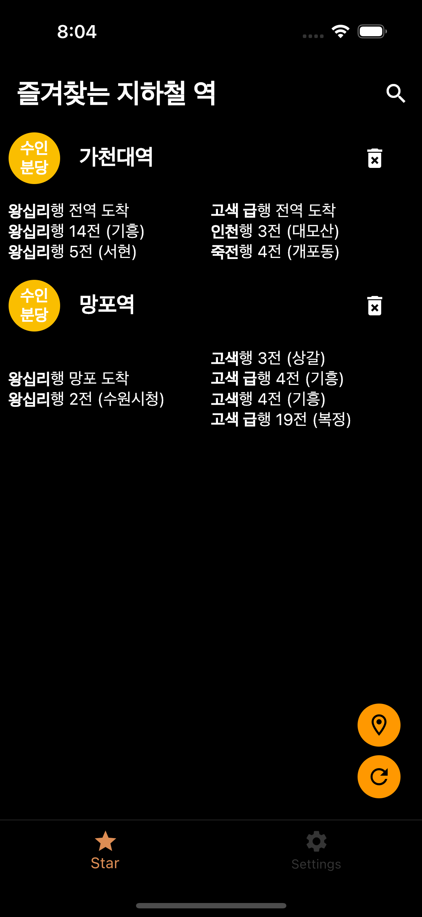
3. refresh
Refresh button can refresh.

Slide 12
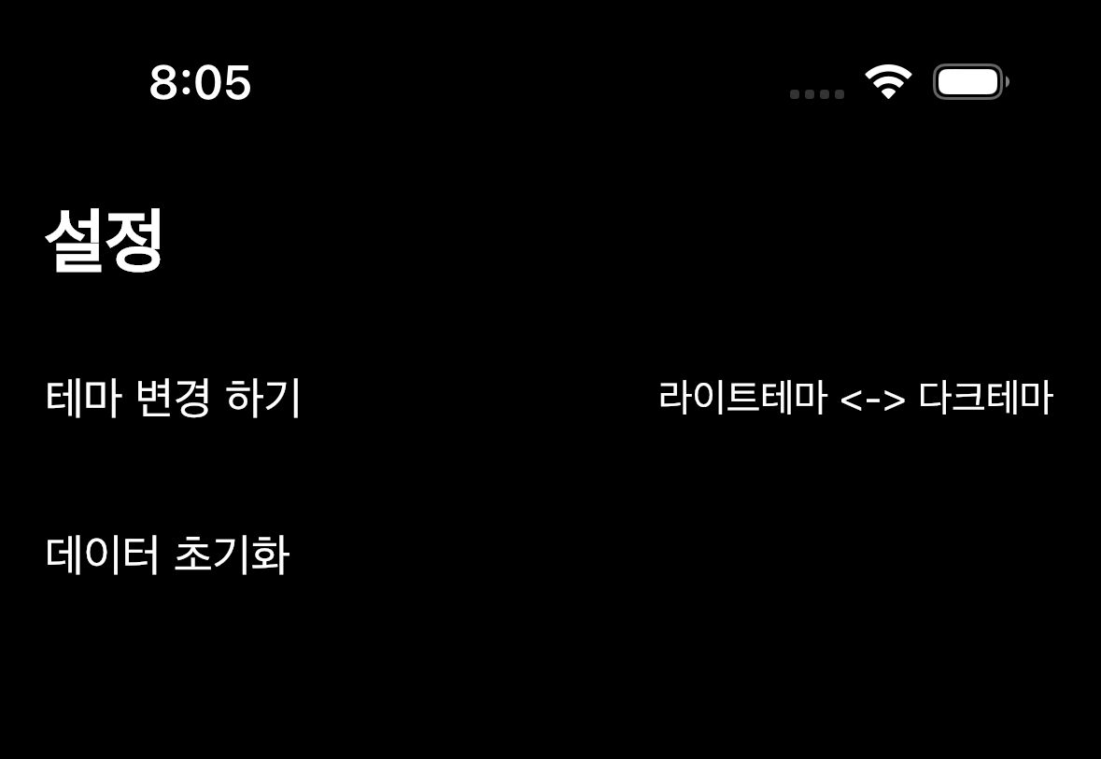
4. settings
You can set theme mode, and data reset.
Data reset can erase all of data.

Slide 13
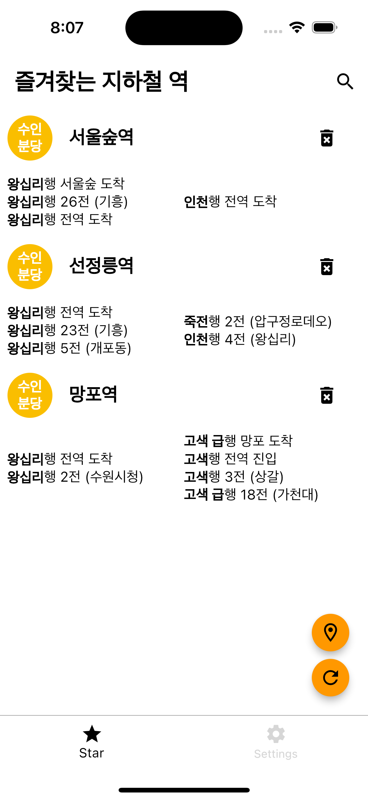
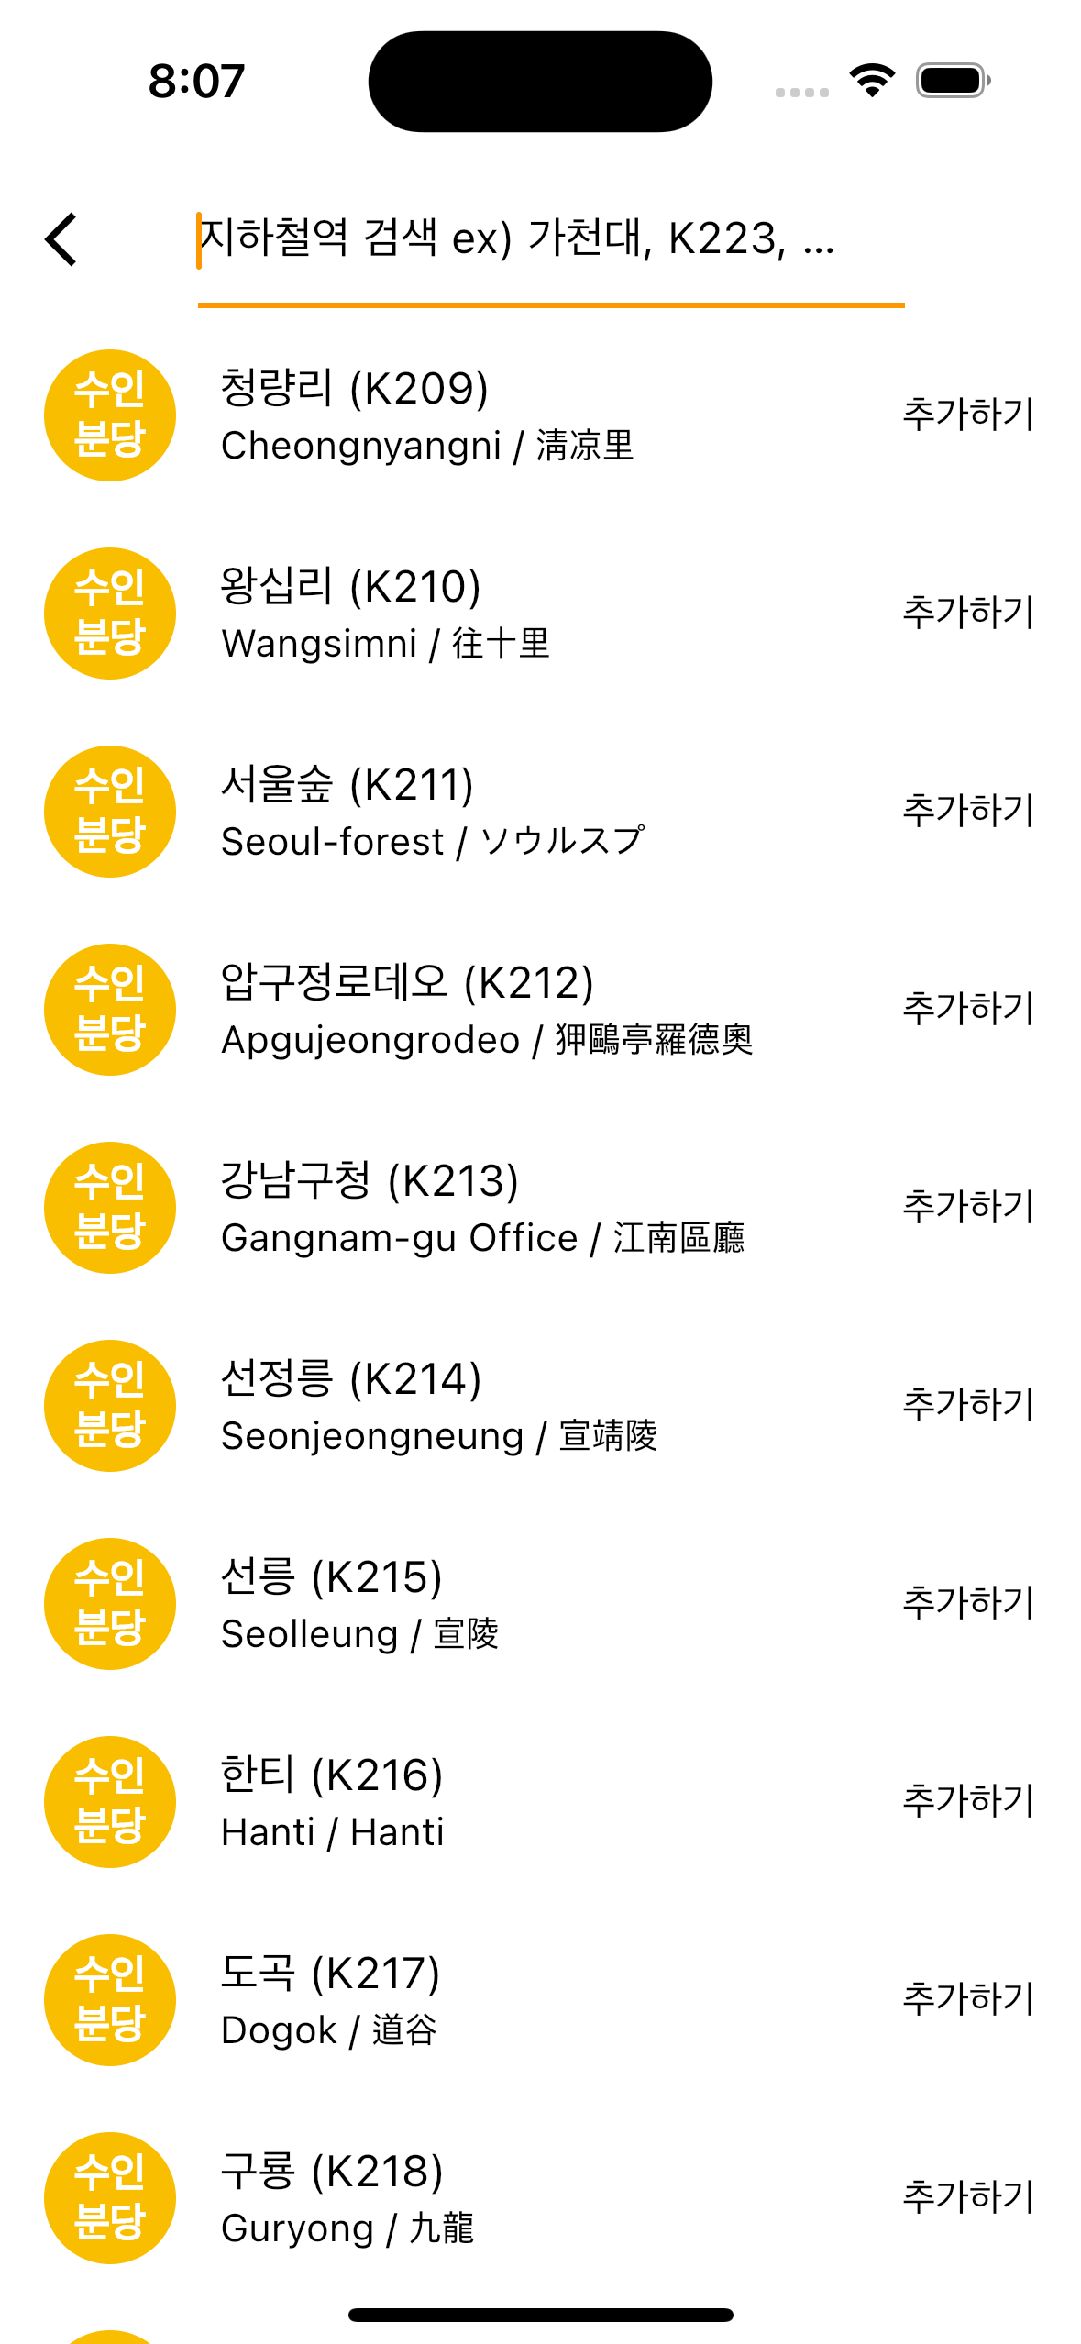
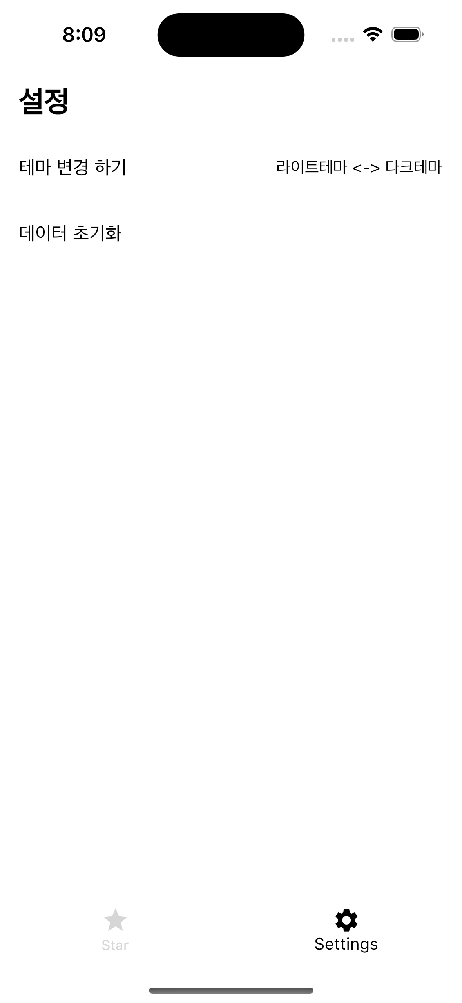
light theme

Slide 14
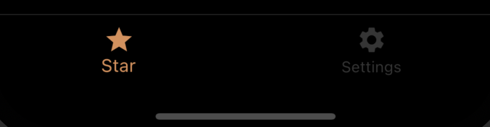
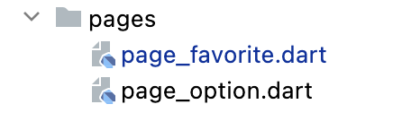
Navigation bar
This bar is navigation bar.
User can switch pages.
Each files contain page’s widgets.

Slide 15
data save method
I used sqflite api to save user data. (database.dart)
Also, I used shared_preferences api to save setting data. Like, theme data.

Slide 16
subway live data api
I can use real time position of subway api to get subway’s information.
I can get information by Network and parse data to use my project.

Slide 17
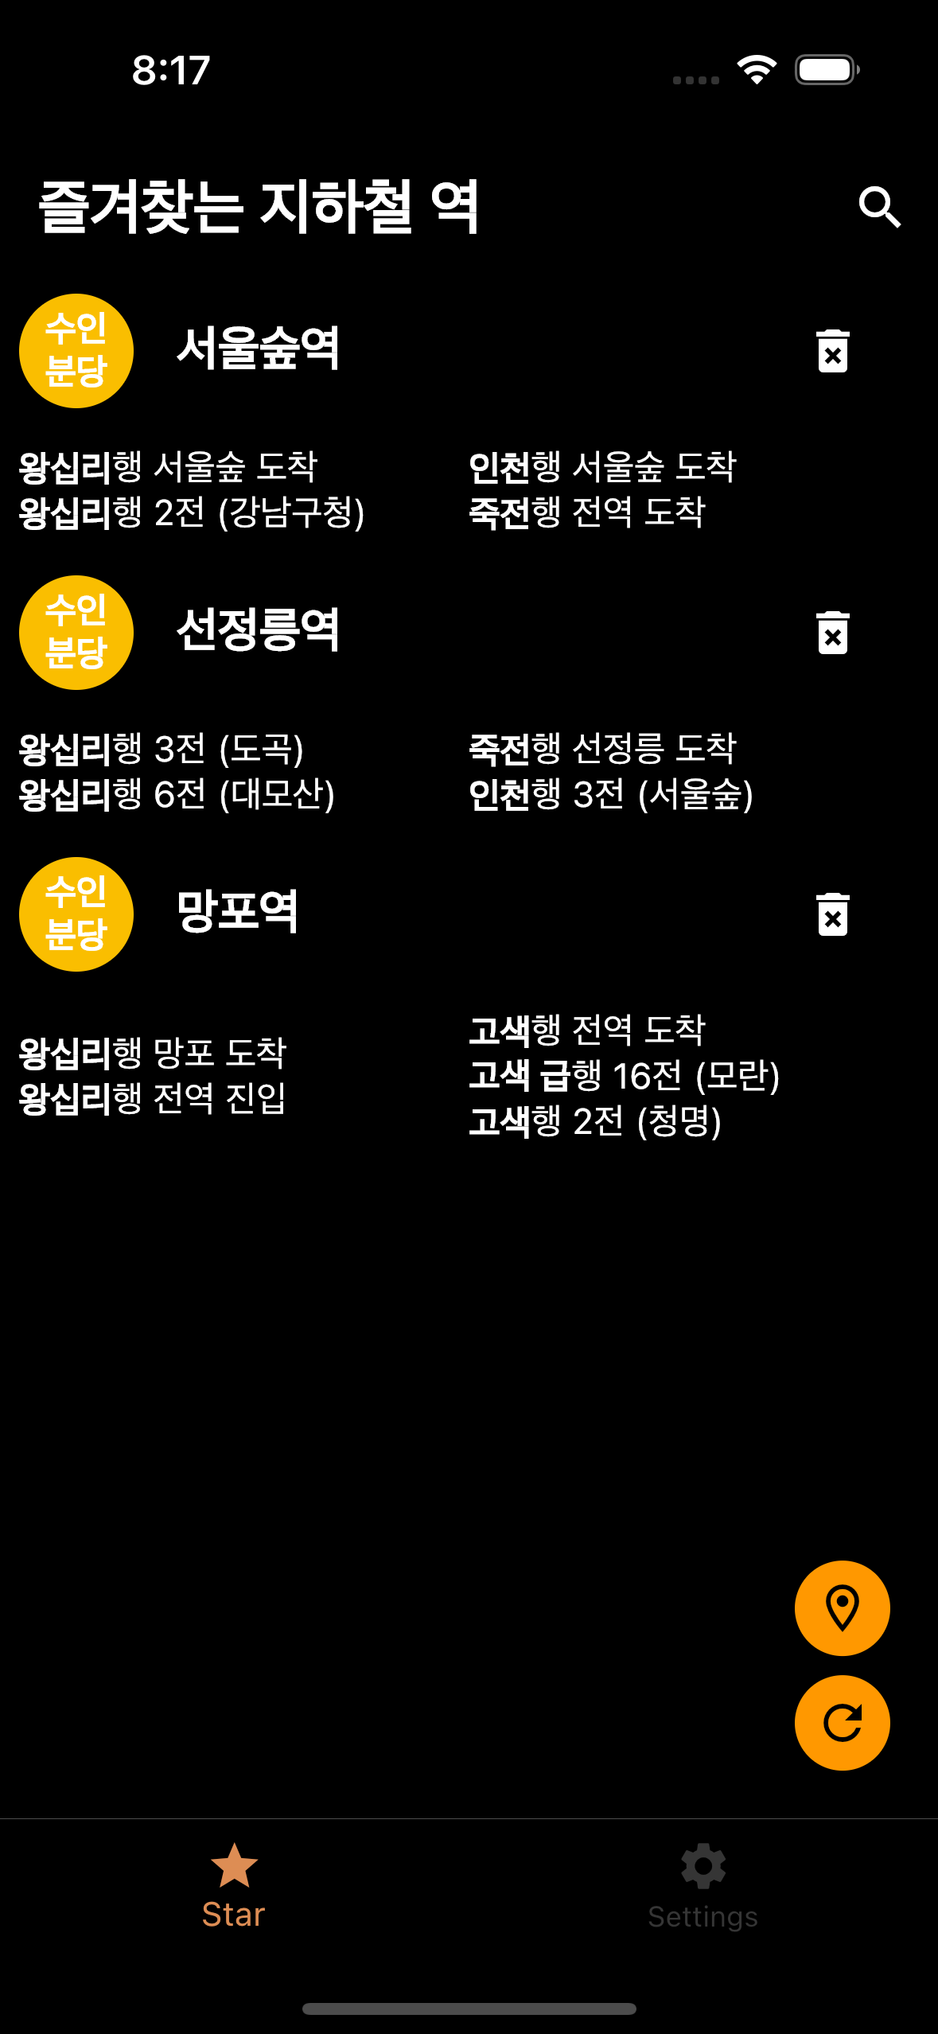
refresh method
This screen is managed by FutureBuilder().
FutureBuilder can catch Future<widget>’s reloading.
So, when widget’s data changed, It can rebuild.

Slide 18
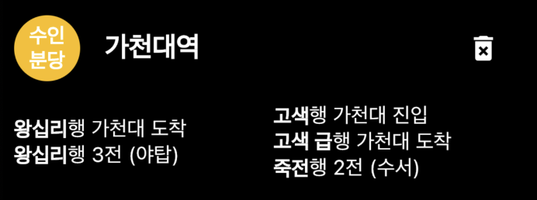
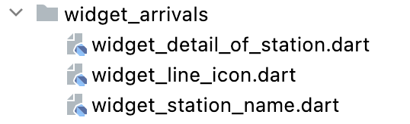
station detail widget
This station’s information is a set of widget.
These files contain definition of widget.
And user can delete station by clicking trash bin.

Slide 19
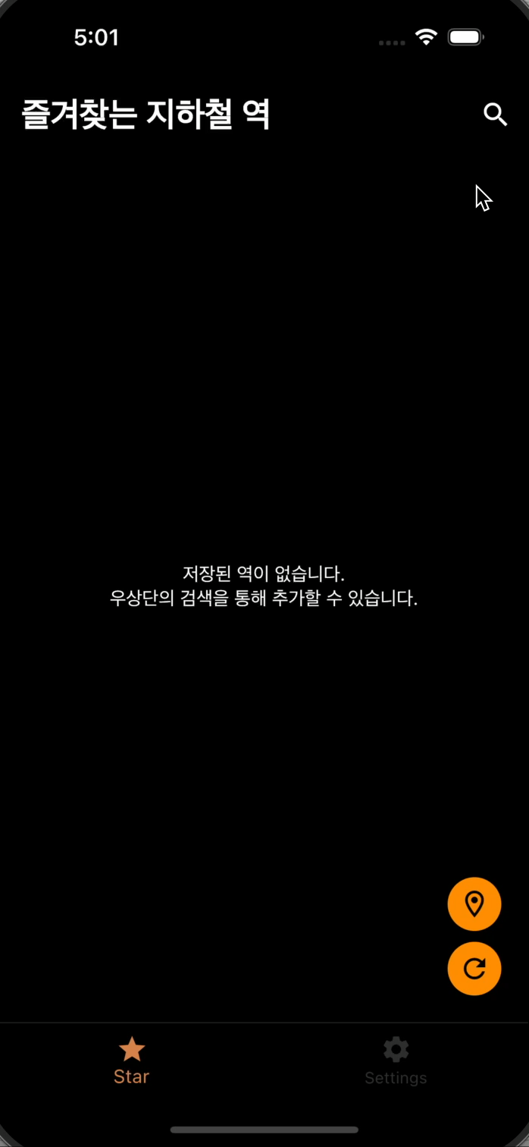
demo
More smooth animations on smartphone :D

Slide 20
limit
Subway’s api key is restricted 1000 times per a day.
It only supports 수인분당선 and some stations have special informations.

Slide 21
Project information
Author – MinSeok Choi
Data – 2023.02.20
Github - https://github.com/waterlemon7z/FindMySubway

